Slide 1

Inside Sales Mastery Series
Effective use of Oracle Eloqua Engage & Profiler
Session # 1
Hosted by: Lead Optimization Team (Marketing Operations)
10 October 2024

Slide 2
Table of Contents
Welcome
Benefits and overview of Eloqua Engage & Eloqua Profiler
Usage of Eloqua Sales Tools (Engage)
Usage of Eloqua Sales Tools (Profiler)
Eloqua Engage Outlook Plug-In
Open Q&A/Discussion​

Slide 3
Welcome to Inside Sales Mastery Series
About this Series
This training series is designed specifically for our inside sales team to enhance your skills in several key areas.
Gain expertise in essential tools and techniques.
Learn best practices to streamline your workflow.
Ensure everyone is on the same page with the latest industry standards and practices.
Ask a question – Pre-submit your questions here or ask during the office hours
Learn how to leverage IQVIA’s marketing systems and processes most effectively
Action: Sign up here, if you need to be added to the outlook invite
Reminder: Save your questions for the end or enter in the chat. We will address as many as we can!

Slide 4
Effective use of Eloqua Engage and Eloqua Profiler

Slide 5
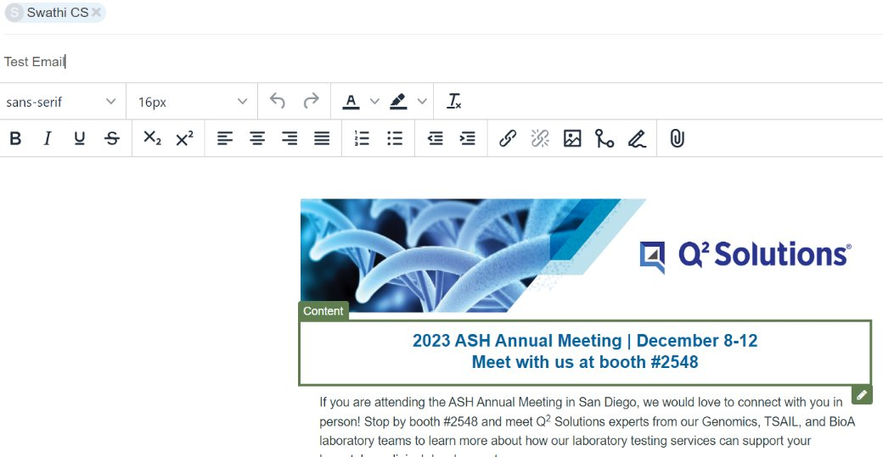
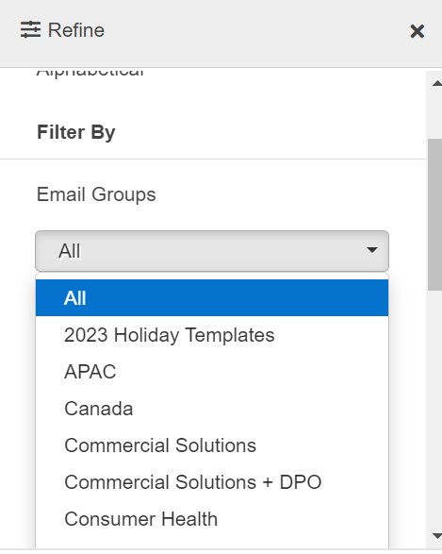
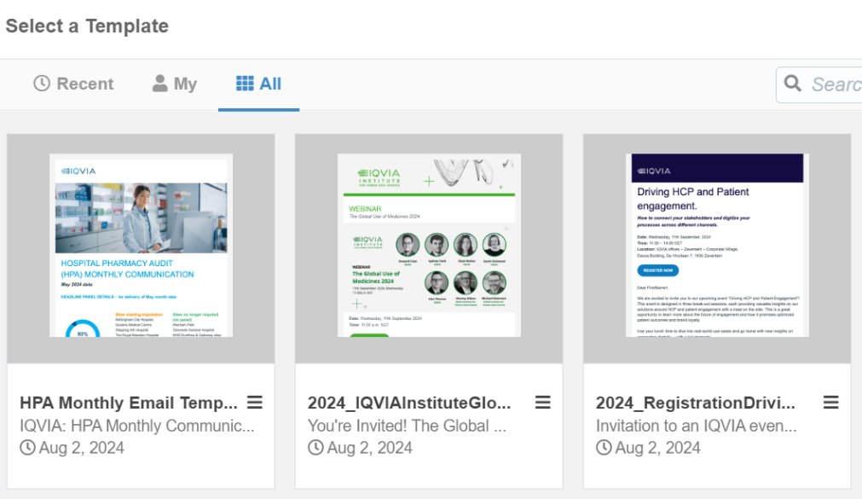
Benefits of Eloqua Engage (embedded within Salesforce)
Sales can easily engage customers with consistent messaging and content
Provides Pre-built marketing templates that sales can easily customize to send personalized email
Use with sales teams to support campaign messaging and sales follow-up
Appropriate for a one send campaign i.e. follow up to an event, one-off notification
Tracks opens and click-throughs in real time
Notes:
Eloqua Sales Tools consists mainly of Eloqua Engage and Eloqua Profiler. Eloqua Engage lives
within Salesforce and provides sales and marketing teams access to all of our marketing emails.
It is typically best used for sales prospecting and for email sends to under 50 contacts. Within
Eloqua Engage you are able to customize and send personalized emails through prebuilt
templates that already exist within Eloqua Engage. Emails that are sent out through Eloqua
Engage have the ability to track open and click-throughs in real time.
You can best use Eloqua Engage by making sales communications for your campaign to be used
as follow-up emails by Inside Sales or your sales teams.
For those of you who may already be familiar with engage I would like to note – Currently, a
new Outlook Plugin is being piloted by the Inside Sales group that makes it even easier to leverage Engage. And so far, the team is having good success engaging with these customers.

Slide 6
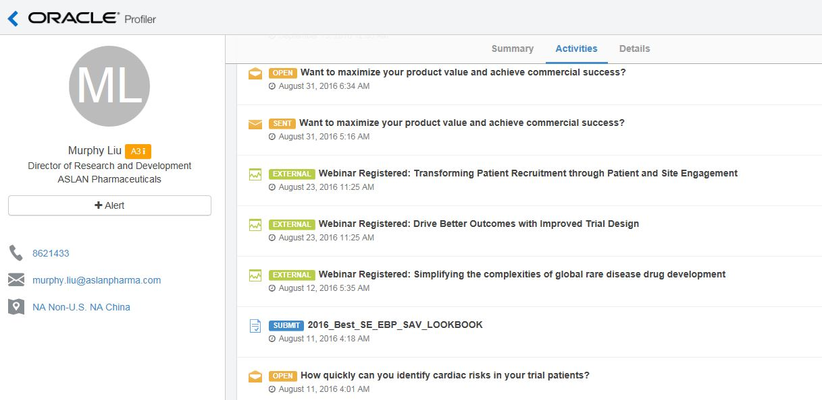
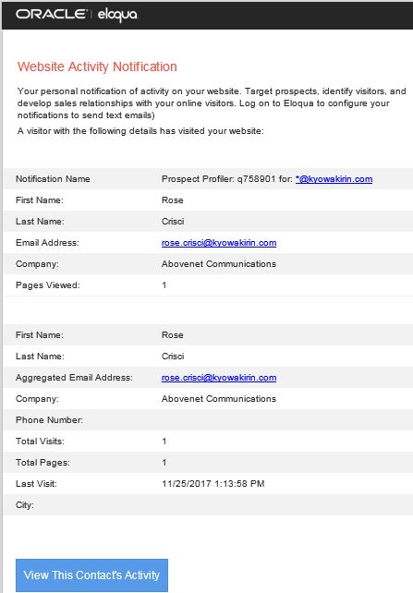
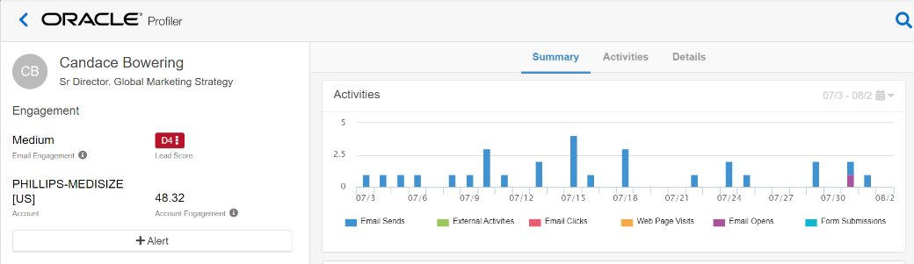
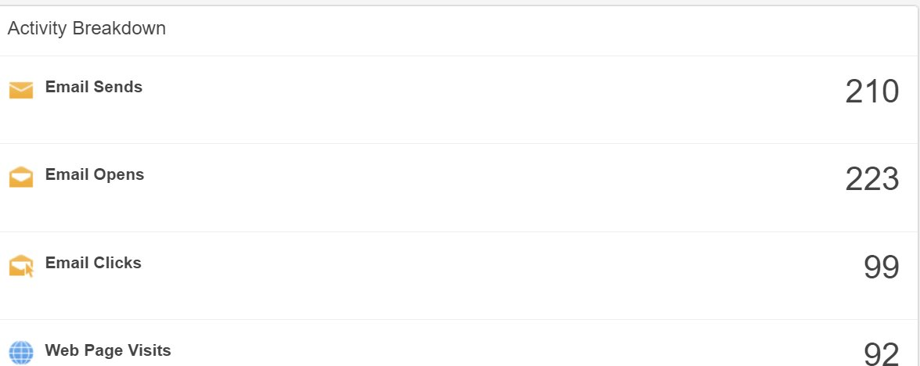
Benefits of Eloqua Profiler (embedded within Salesforce)
Customer 360 View provided to the Sales Team
View customer activity profiles in one place
Shows summary and details of customer online activities & behaviors (clicks, opens, etc.)
Provide real-time email alerts to sales of prospect visits to IQVIA.com
Customer Insight provided to the sales team for each contact and lead
Notes:
Eloqua Sales Tools consists mainly of Eloqua Engage and Eloqua Profiler. Eloqua Engage lives
within Salesforce and provides sales and marketing teams access to all of our marketing emails.
It is typically best used for sales prospecting and for email sends to under 50 contacts. Within
Eloqua Engage you are able to customize and send personalized emails through prebuilt
templates that already exist within Eloqua Engage. Emails that are sent out through Eloqua
Engage have the ability to track open and click-throughs in real time.
You can best use Eloqua Engage by making sales communications for your campaign to be used
as follow-up emails by Inside Sales or your sales teams.
For those of you who may already be familiar with engage I would like to note – Currently, a
new Outlook Plugin is being piloted by the Inside Sales group that makes it even easier to leverage Engage. And so far, the team is having good success engaging with these customers.

Slide 7
Eloqua Engage

Slide 8
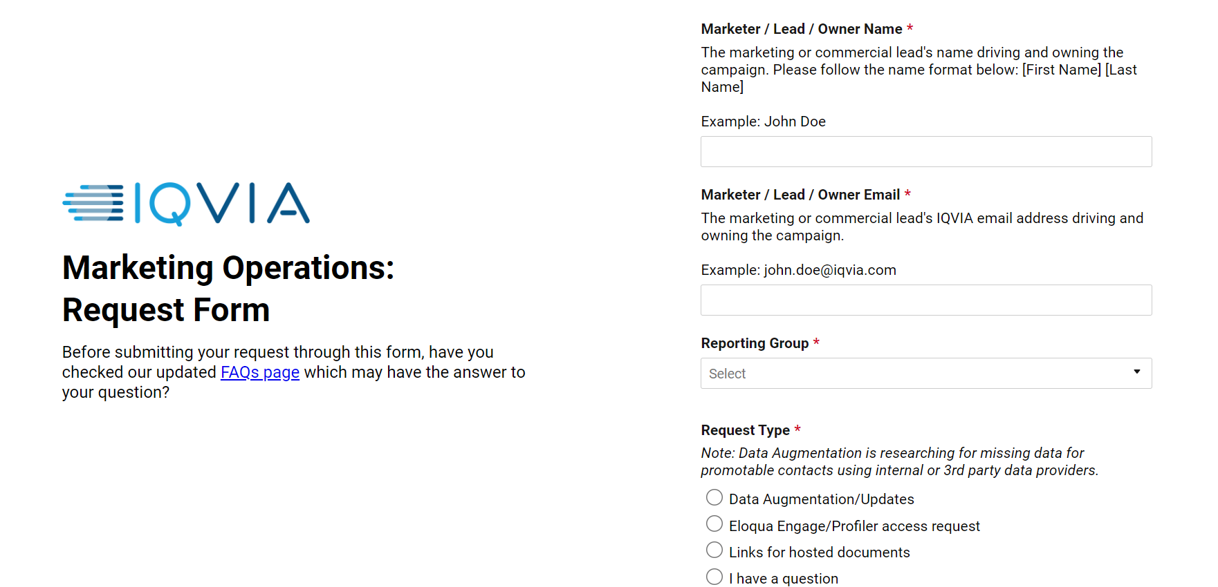
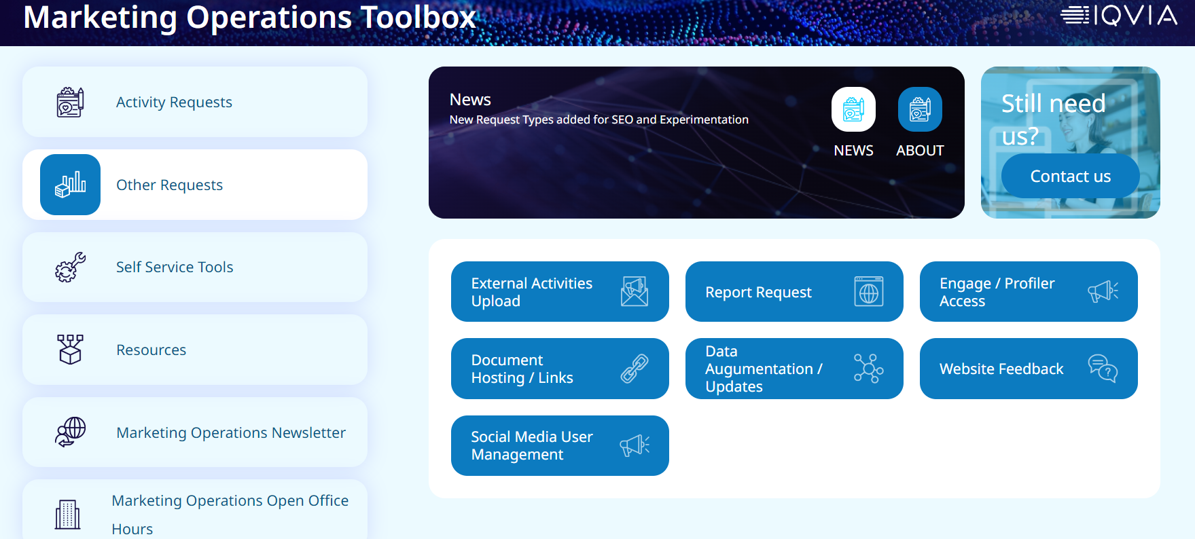
Use cases
IQVIA - Marketing Operations Toolbox
Sales Outreach: Quickly send personalized emails to prospects using pre-approved templates.
Follow-Up Emails: Automate follow-up emails after meetings or calls to keep the conversation going.
Event Invitations: Send out invitations for webinars, conferences, or other events with ease.
Product Announcements: Inform prospects and customers about new products or updates.
Customer Engagement: Maintain regular contact with customers to build and strengthen relationships

Slide 9
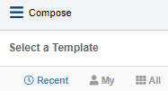
Eloqua Engage: Selecting a Template
ELOQUA ENGAGE: SELECTING A TEMPLATE
Log into Salesforce
Navigate to Eloqua Engage
Click on “Compose”
Choose a template
Recent | My | All
Navigate to All – Filter to find a specific template saved in a particular location
If you know the template name you can type it in. It may be helpful to provide the Sales team with your campaign code so that they can search the templates available to them for that campaign
2021_CSMSDynDplyWbnrEmNur_USCAusa_SS
Natalie Demo Email Template

Slide 10
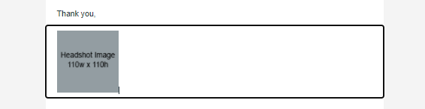
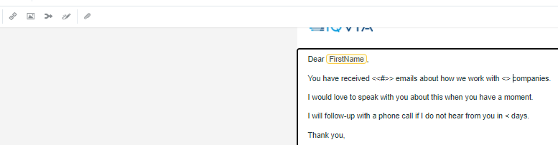

Eloqua Engage: Editing the Email
ELOQUA ENGAGE: EDITING THE EMAIL
Once you have selected your template, you can make edits to it
To delete a content block that you don’t want, simply highlight it and delete
To insert field content into the email, select Field Merge from the top ribbon banner
Here you can select, FirstName or Company if you desired that information to be pulled into the email
Here, you can preview your email to see what it would look like to the recipient

Slide 11

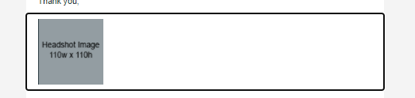
Eloqua Engage: Adding an Image
ELOQUA ENGAGE: ADDING AN IMAGE
If you would like to upload an image, put your cursor where you would like the image and select "Upload Image"
Select Upload in the right hand corner and upload the image you want to use
You will want to upload the image with the size dimensions desired, as you cannot alter the image size within Engage
The maximum size for an upload in Images is 50 MB

Slide 12

Eloqua Engage: Adding a file to your email
ELOQUA ENGAGE: ADDING A FILE TO YOUR EMAIL
We typically recommend sending a link to document vs having it attached in the email for tracking purposes.
In order to add a file to your email, Select the attachment icon in the editing banner
Select the attachment if it is already uploaded or select the upload button to upload your attachment
Insert the file as a tracked link
The maximum size for an upload in File Storage is 10 MB

Slide 13
Eloqua Engage: Adding New Contact Records
ELOQUA ENGAGE: AUDIENCE UPLOAD GUIDELINES
New contacts records can be created directly in Engage or Salesforce.
Salesforce and Eloqua Synch daily.
If a new contact is needed immediately for a delivery, enter the contact in Engage.
All new contacts need the following minimum information
First Name
Last Name
Email Address
Job Title
Company
Country
In the rare situation that you have a large number of contacts that need uploading, follow the process outlined here and send your file to marketing.automation@iqvia.com

Slide 14
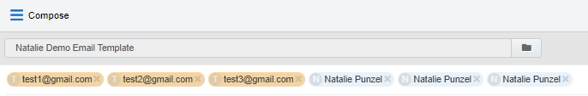
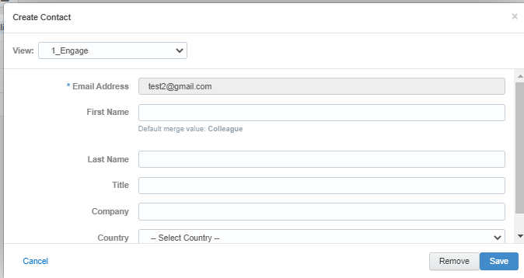
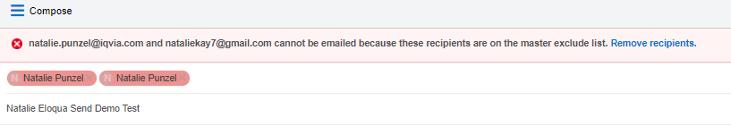
Eloqua Engage: Select the Audience
ELOQUA ENGAGE: SELECT THE AUDIENCE
To enter email addresses into the email, you can manually enter your recipients' email addresses or copy and paste contacts from Microsoft Outlook, as well as XLS and CSV files
As you enter an email recipient's name or email address, Engage searches your Oracle Eloqua contacts. If you enter an existing Oracle Eloqua contact, the name is displayed in blue. New email addresses that do not match Oracle Eloqua contacts, or ones missing a field merge value, display in orange. You are prompted to save these recipients as contacts before sending the email.
Engage displays warning messages if contacts are globally unsubscribed or if the email addresses are flagged as bouncebacks. These contacts are displayed in red. After clicking Send, Engage provides a list of any recipients who will not receive the email because they are either on the master exclude list or unsubscribed from the email group

Slide 15

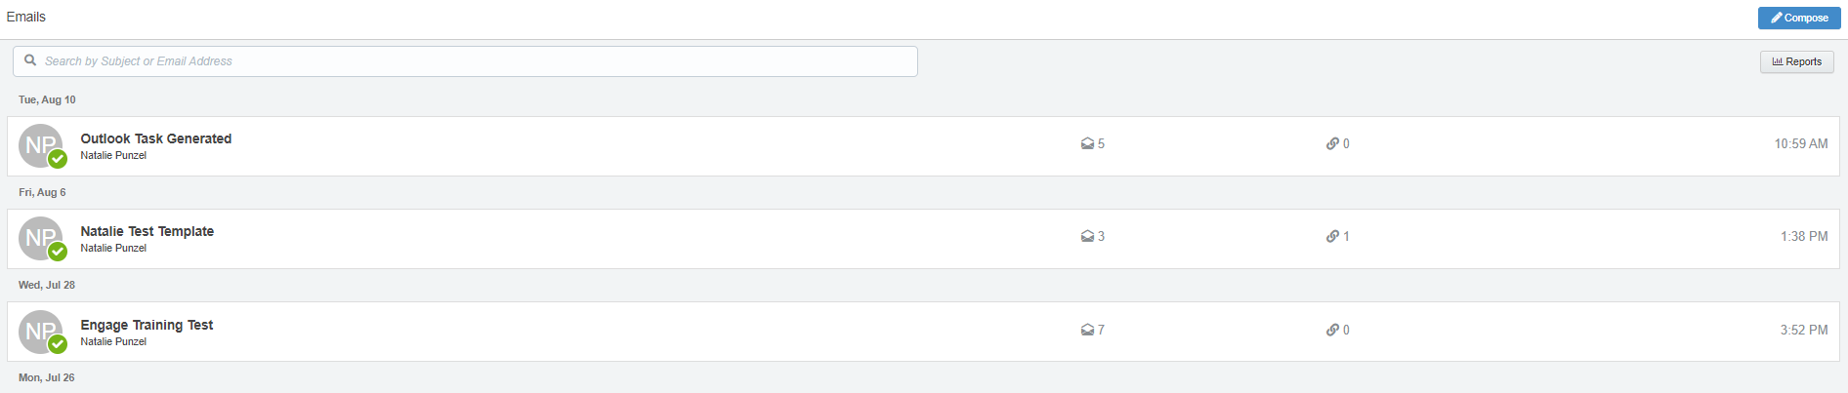
Eloqua Engage: Sending the email
ELOQUA ENGAGE: SENDING THE EMAIL
Once you have your audience selected, you can then go ahead and send your email
Once the email is sent, it will display on your Eloqua Engage homepage
On your Eloqua Engage homepage, you will be able to see engagement come in from your email in real time

Slide 16
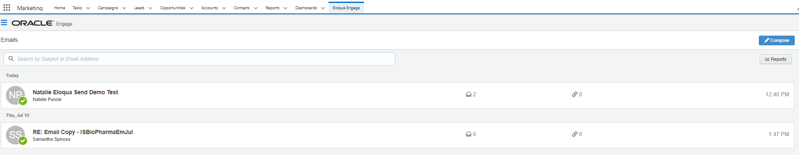
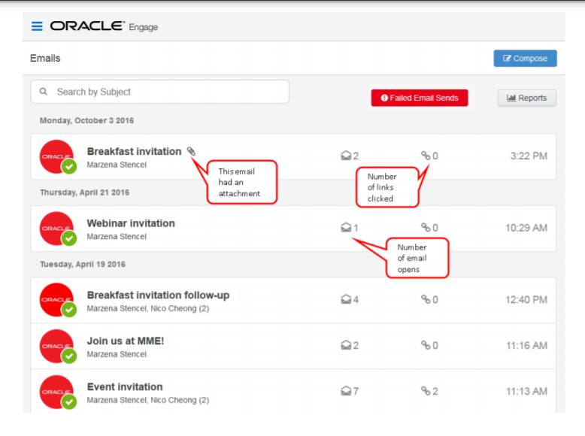
Eloqua Engage: Reporting
Once the email is sent, Engage displays your Recent Emails Sent history and send status.
To view email sent history:
Navigate to the Engage home page by logging into Salesforce and clicking the Engage icon:
Engage displays a list of successfully sent emails along with their sent status, date, and number of email opens and clicks.
A green icon indicates the email was sent successfully to all recipients.
An orange icon indicates the email was sent successfully to some recipients.
A red icon indicates the email was not sent successfully to any recipients.

Slide 17
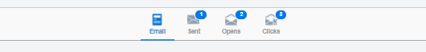
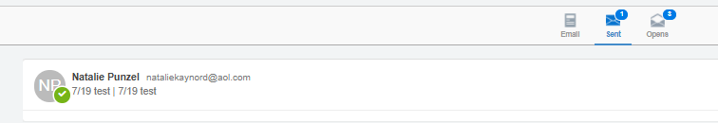
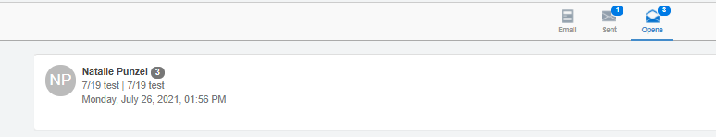
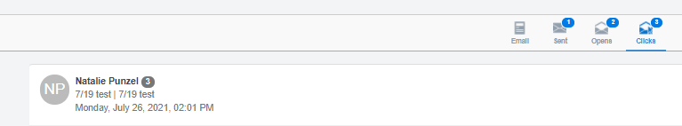
Eloqua Engage: Reporting
Select an email to view additional details. Explore the different tabs to learn more about your sent email.
Emails tab: Displays a thumbnail image of your email
Sent tab: Displays the recipients of the email. Here, you can click a recipient’s name to view additional details.
Opens tab: Displays the recipients who opened the email and
Clicks tab: Displays the recipients who clicked a link in the email

Slide 18
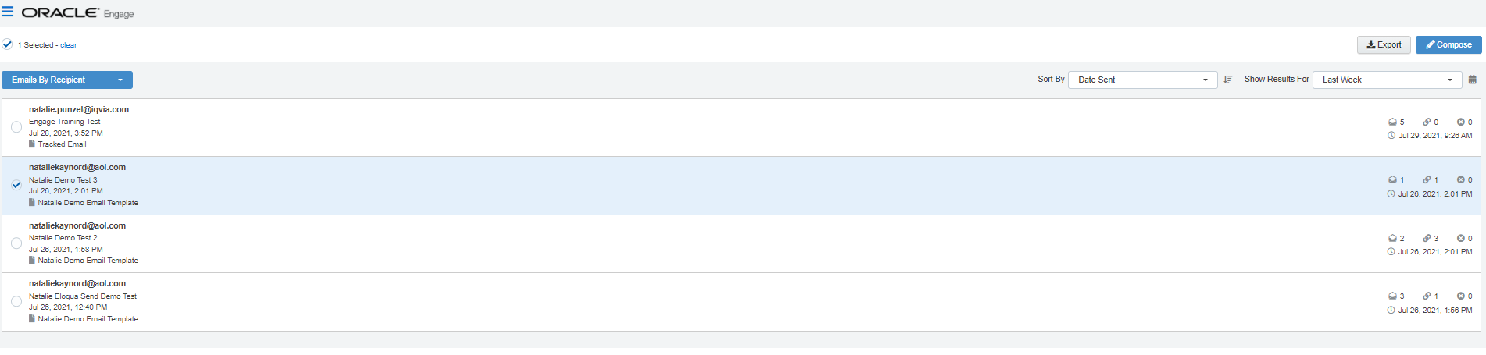
Eloqua Engage: Reports
Engage reports provide insight about the performance of your sent emails. Access reports by opening Engage and clicking Reports on the sent emails page
Tip: You can send an email using one of the templates in your report results.
There are two Engage report types available:
Engage top templates report
The Engage top templates report provides information about the performance of your templates over a given period.
You can utilize this report to gain an understanding of your top performing templates. You are than able to reuse the templates that have the best performance for future emails
Engage emails by recipient report
The report displays a list of recipients for your sent emails. Emails sent to multiple recipients are listed individually.
You can utilize this report to view who has engaged with your email and follow up with them easily if desired. You can click on the recipient's name and select "Compose" to follow up directly with any recipient within this report.

Slide 19
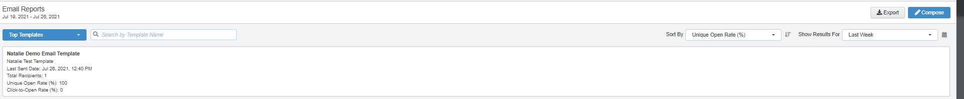
Eloqua Engage: Top Templates Report
The Top Templates report displays emails sent by the logged-in user
Use the search and date picker to limit the number of templates displayed:
Search by template name.
Filter results by date sent. Use the standard time frames from the drop-down list or enter a custom date by clicking the calendar icon. The default time frame is the Last Week.
Results are sorted by highest unique open rate by default. Use the Sort By drop-down list to sort by a different metric.
This report captures the following metrics.
Unique Open Rate
The unique opens divided by the total number of times an email was delivered. (Unique Opens / Total Delivered) A unique open is the number of recipients (original recipients or email forwards) that opened an email at least once. This does not count all the times that the same recipient opened the email.
Click-to-open rate
Clicked sends / opened sends. Both clicked sends and opened sends ignore possible forwards. Clicked sends: The first clickthrough by the original recipient. This metric ignores possible forwards. Opened sends: The number of first opens for the email.

Slide 20
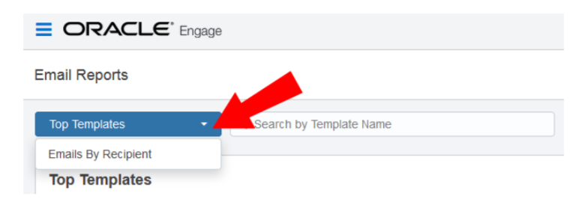
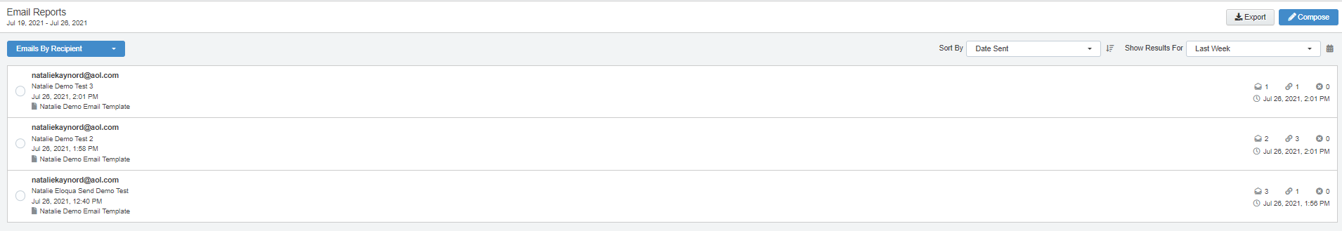
Eloqua Engage: Follow-up Using Top Recipient Report
The Top Recipient Report can be found in the Top Templates drop-down
Use the date picker to limit the number of email recipients displayed. Use the list’s standard time frames or enter a custom date by clicking the calendar icon. The default time frame is Last Week.
Results are sorted starting with the most recently sent email by default. Use the Sort By drop-down to sort by a different metric.
This report captures the following metrics.
Total opens
The number of times an email was opened. This includes multiple opens by the original recipient or forwarded recipient.
Total clicks
The total click-throughs. This includes multiple clicks by the same recipient. System Action links are not tracked.
Hard bouncebacks
The total emails that returned a hard bounceback.
A hard bounce is an email that permanently could not be delivered. Some common reasons for hard bounces include an invalid email address or domain name.

Slide 21
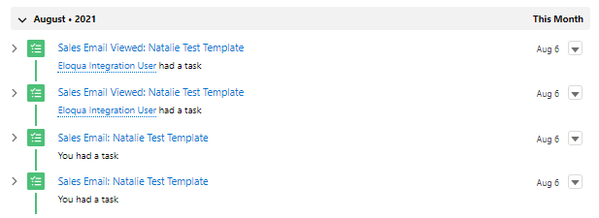
Eloqua Engage: Tasks Generated in Salesforce
When you do send your emails out of engage, the action counts as a “task.” Once the email is sent, a task will be created and marked as complete.
If the contact opens the email, another task will be created on the record that opened the email

Slide 22
Eloqua Profiler

Slide 23
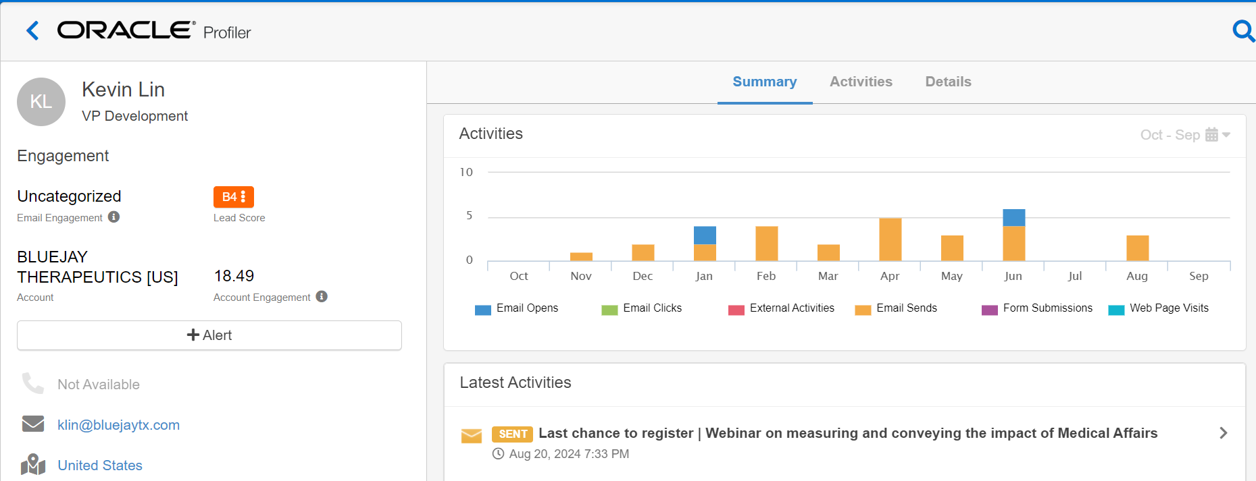
Know your Buyer
Profiler
Identify stakeholders
1
Analyze digital body language
2
Set activity alerts
3

Slide 24
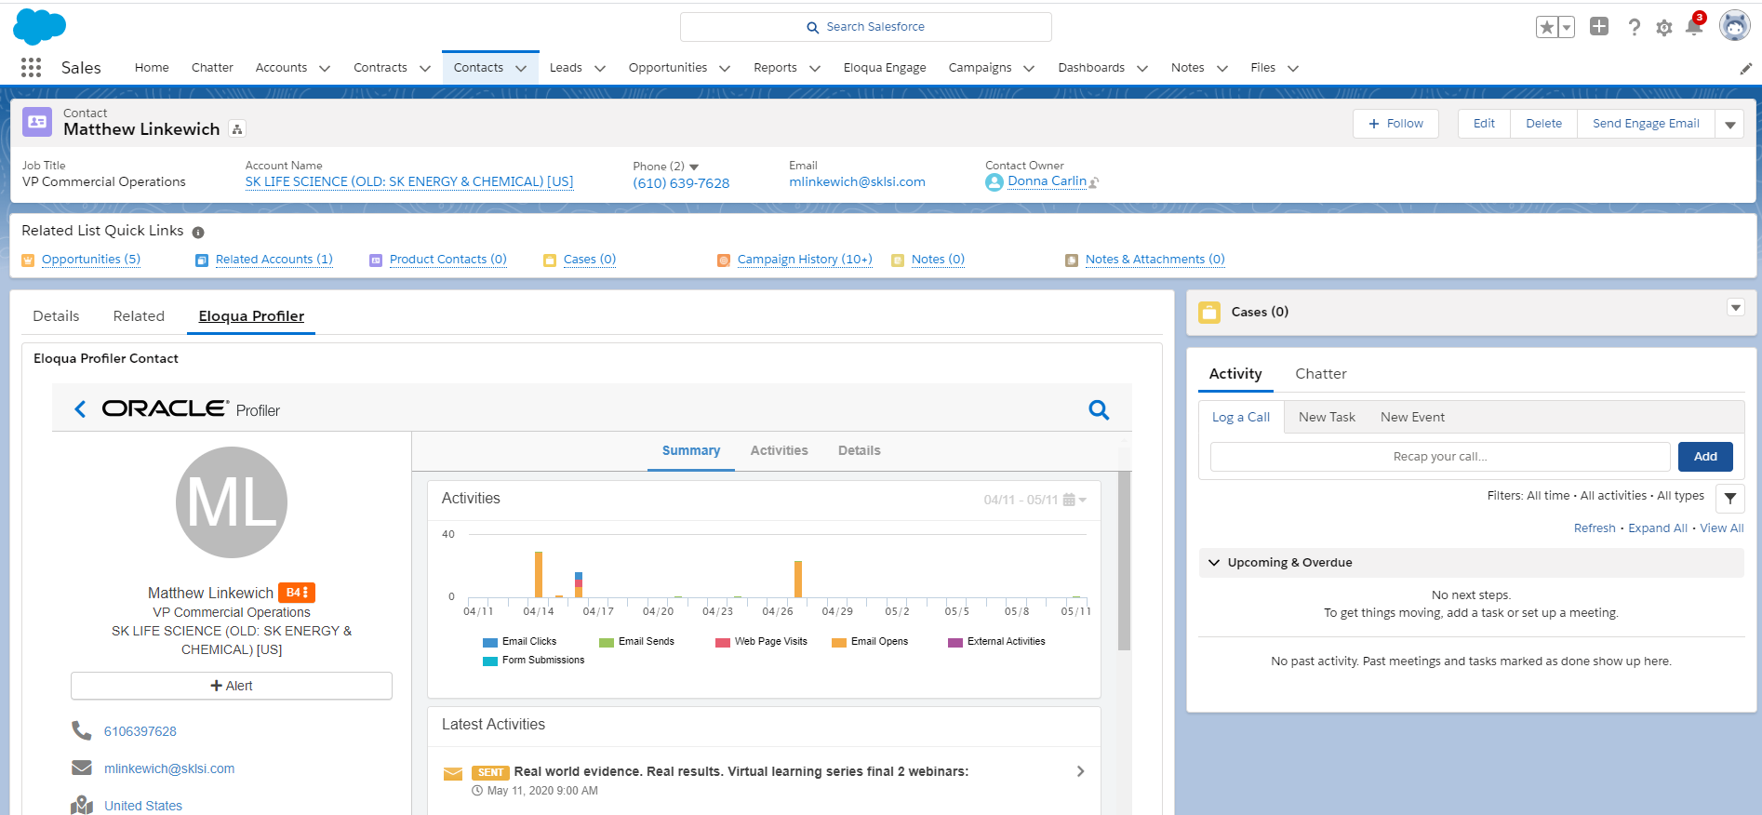
Profiler is Located on Salesforce Lead and Contact Records
Select this tab on the lead/contact layout to see this specific view

Slide 25
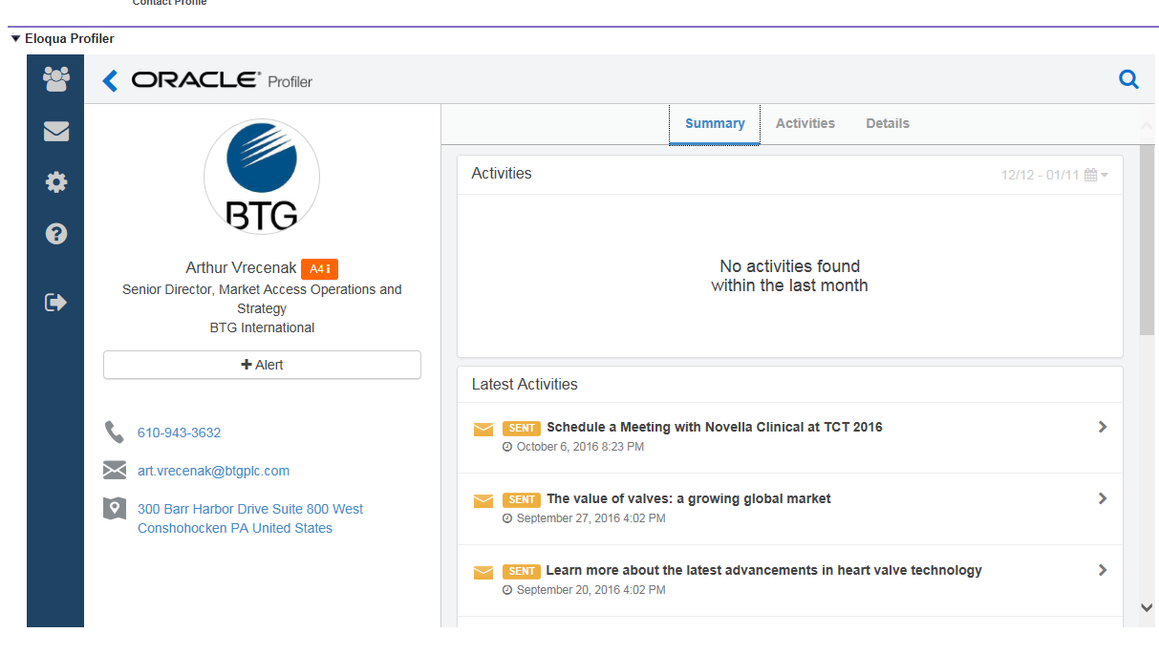
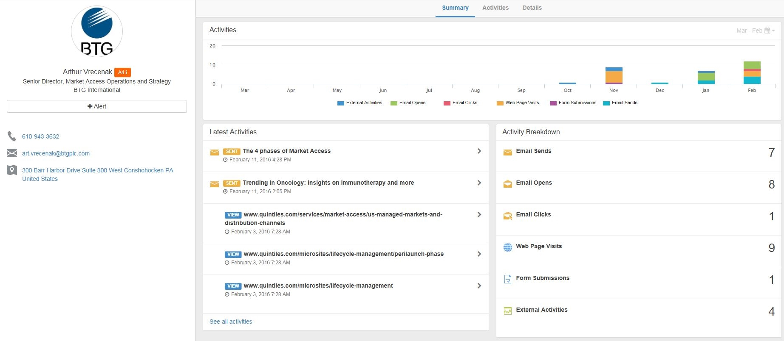
Scroll down on summary tab to view latest activities
You can view what emails a contact has received/opened, which web pages they have visited and any webinars or events they have attended. To amend the time period use the calendar icon (last 30/60 days, or 1 year)

Slide 26
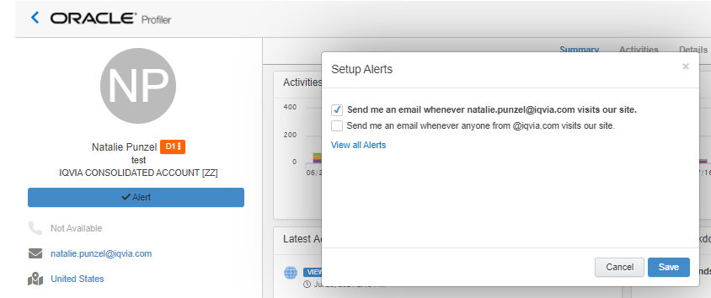
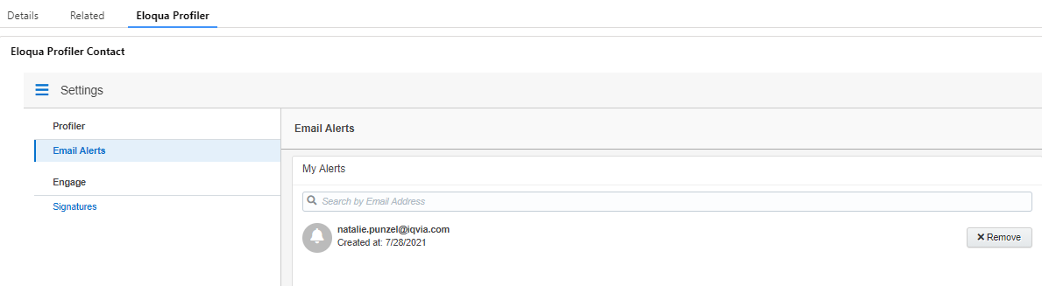
Eloqua Profiler Web Alerts
REMOVE ELOQUA PROFILER
WEB ALERTS
Search the contact you would like to remove as a web alert
Click on their name and select "Eloqua Profiler"
Click the blue "Alert" box
In the pop-up window select "View all Alerts"
Here all your web alerts will be listed, remove the alerts you no longer want to receive

Slide 27
Eloqua Engage Outlook Plug-In

Slide 28
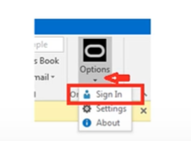
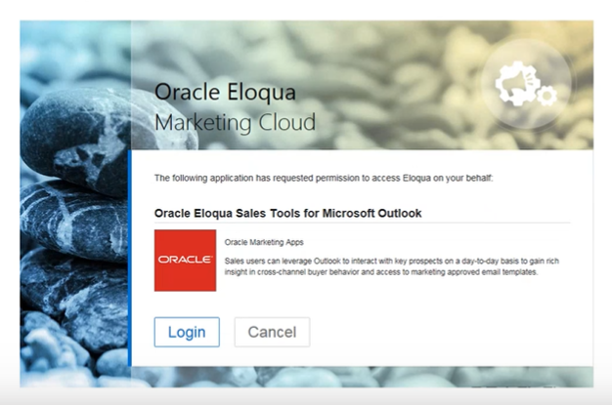
Eloqua Engage Plug In: First Steps
1. Download the Oracle Eloqua Sales Tools for Microsoft Outlook
- Instructions can be found here on page 10
- You may need to request the Outlook App in Via here.
2. Documentation can also be found in the Eloqua help center here
3. Once installed, you will have a new icon within your Outlook, you will need to sign into your Eloqua account
4. To sign into your Eloqua account, click on “Options” on the icon and “Sign In”
- Login using your Eloqua Credentials
- Users need to have access to Eloqua Engage and Eloqua Profiler to avoid login-issues
- For any support needs for Engage or the Outlook Plug-in please submit a VIA ticket.
- If you experience log-in issues, reach out to marketing.automation@iqvia.com

Slide 29
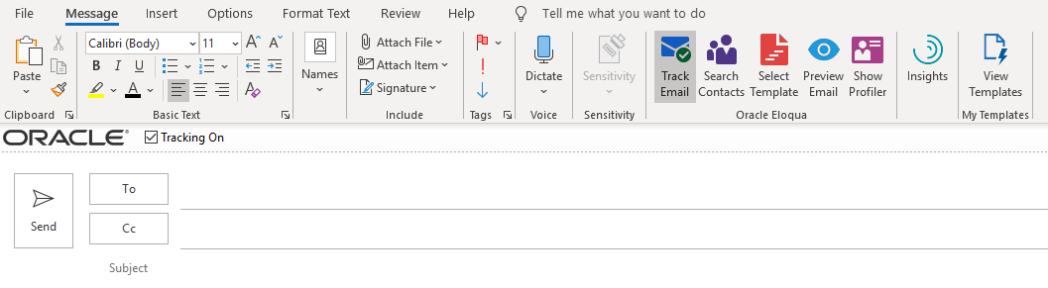
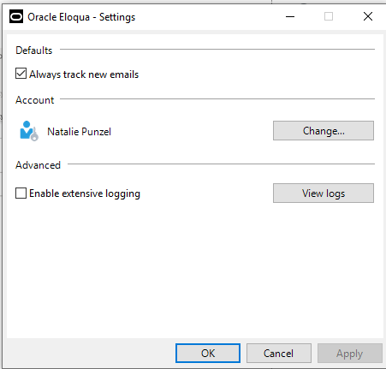
Outlook Eloqua Engage Plug-In
OUTLOOK ELOQUA ENGAGE PLUG-IN OVERVIEW
Download Outlook plug-in app to view new ribbon options.
By default, tracking will be enabled. Tracking is enabled when the tracking box is checked.
Once this box is checked and an email is sent, this email will be tracked by Eloqua.
When the “Tracking On” box is not checked, the message is sent as a personal email and is not tracked.
Uncheck the tracking box if you would like to remove tracking. You can also logout of the Oracle App if you do want the new options to appear.
You can also change the default so that the “Tracking On” box is unselected by default therefore having to check it when you want the email to tracked. To do that, go to the Oracle App and select “Settings” and uncheck “Always track new emails.”

Slide 30
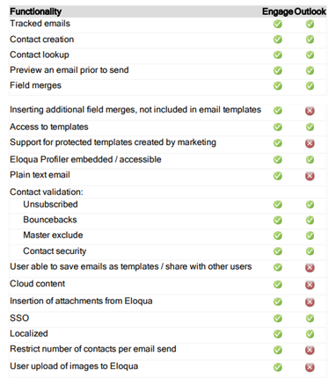
Outlook Eloqua Engage Plug-In
OUTLOOK PLUG-IN VS. ENGAGE
Within the Outlook Plug-In you will not be able to:
Insert additional fields merges
Have support for protected templates created by marketing
Have a plain text email
User will be unable to save emails as templates and share with others
Cloud content will not be available
Cannot insert attachments from Eloqua
Restricts the number of contacts per email send
Cannot upload images from Eloqua

Slide 31
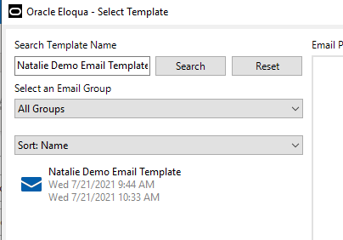
Outlook Eloqua Engage Plug-In
SELECT A TEMPLATE WITH OUTLOOK PLUG-IN
You can create your own personalized email or select a template
You can search templates by the template name. At least three characters must be specified to search.
You can narrow the search by selecting specific email groups. You can sort templates by name, creation date, or modified date.
There are pre-made templates created within Engage that you can choose if you would like:
Starter Engage Template Names – search these templates in Engage. Do a “Save As” – to create a new email
Blank Template without Signature field merge w/ IQVIA logo
Inside-Sales-Blank-Template_2.0_Blank
Blank Template with Signature field merge w/ IQVIA logo
Inside-Sales-Blank-Template_2.0
Blank Template looks like it is coming from Outlook
2021_Inside_Sales_Blank_Template_Outlook_Version_2.0

Slide 32
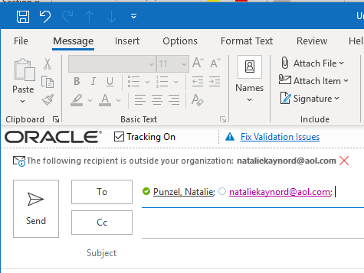
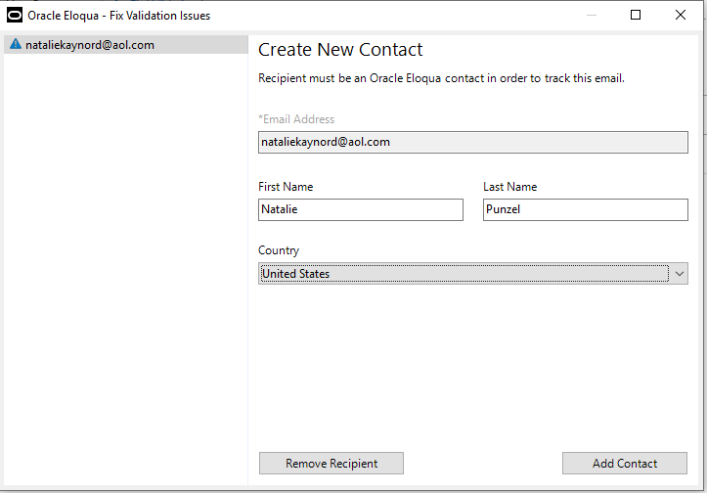
Outlook Eloqua Engage Plug-In
ADD CONTACTS WITH OUTLOOK PLUG-IN
Either type a single contact's name into the address bar or copy and paste a list into the address bar
Once you enter in the contact’s information, if the contact is in the database, you will have no issues and you will be able to add them to your recipient list.
If the contact you try and enter is not in the database, you will get a “Fix Validation Issues” alert within your email address bar. You will need to click on that and add that contact to the database. If you don’t want to add that person, select “Remove Recipient.”

Slide 33
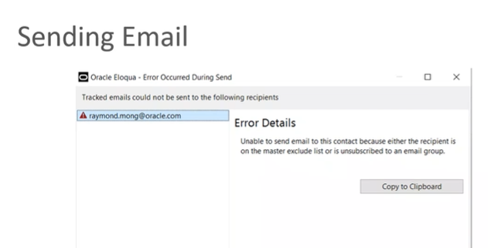
Outlook Eloqua Engage Plug-In
PREVIEW AND SENDING AN EMAIL WITH OUTLOOK PLUG-IN
Once you have the email completed you can click on Preview to see how the email will look to the recipient
When you are ready to send the email, you can click Send.
Another validation will be ran at this time to see if there are any issues with the recipients
If there are issues, you will get a prompt telling you why
Any email address that does pass this validation will not receive the email

Slide 34
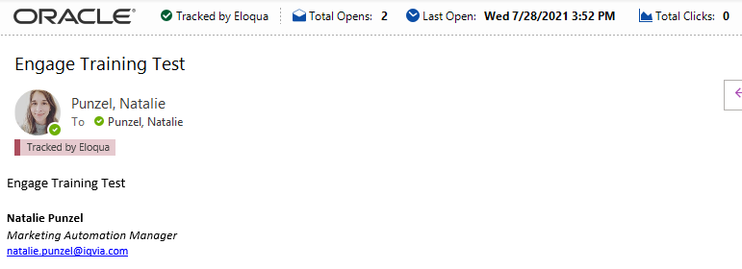
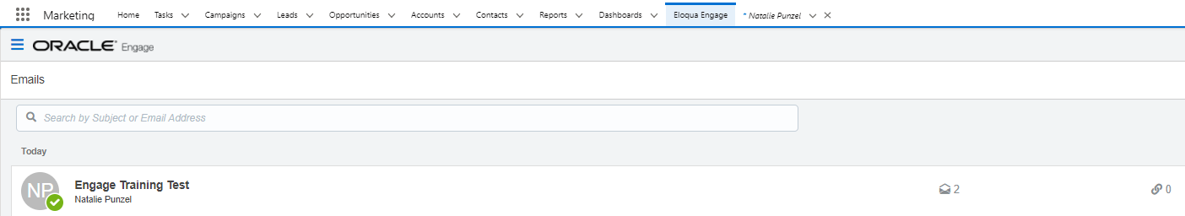
Outlook Eloqua Engage Plug-In
EMAIL SEND METRICS WITH OUTLOOK PLUG-IN
You can check the email send metrics in Outlook by navigating to the Sent Email Folder and opening the email that was sent
The correspondence will also show up within Salesforce Engage as well

Slide 35
Open Q&A/Discussion

Slide 36
Resources
Eloqua Training Materials and Documentation
Oracle Eloqua Engage User Guide
Oracle Eloqua Sales Tools User Guide
Profiler Training Resources
Engage Training Resources
Training Videos
Getting Started Video on Profiler (5 minutes)
Eloqua Profiler Overview (3 minutes)
Getting Started Video - Engage (3 minutes)
Eloqua Engage Outlook Plug-In
Request the Oracle Outlook Plug-In in VIA
Eloqua Salesforce Reports
SFDC Contacts Report for Eloqua Engage
SFDC Lead Report for Eloqua Engage
Engage Task Report
For any support needs for Engage or the Outlook Plug-in please submit a VIA ticket.

Slide 37
Thank You

